Slide 1

Cucumber Diseases Recognition

Slide 2
Presented By
Name | ID
Mubashir Jawad | 2022-2-60-039
K. M. Sakif Muhtasim | 2022-2-60-025
Sonia Bente Siraj | 2022-2-60-087
Sumaiya Binte Naser | 2022-2-60-155

Slide 3
Objectives
Create a comprehensive cucumber disease dataset with multiple disease classes
Support the development of machine vision–based disease recognition models
Enable automatic and accurate identification of cucumber diseases
Improve agricultural efficiency and crop productivity
Contribute to food security through early disease detection

Slide 4
Methods
Trained Model:
EDA
Supervised Pretrained Model
EfficientBO
ResNet_50
Vgg_16
Custom CNN
Attention Enhanced CNN Model
Explainability and Generalizability Testing

Slide 5
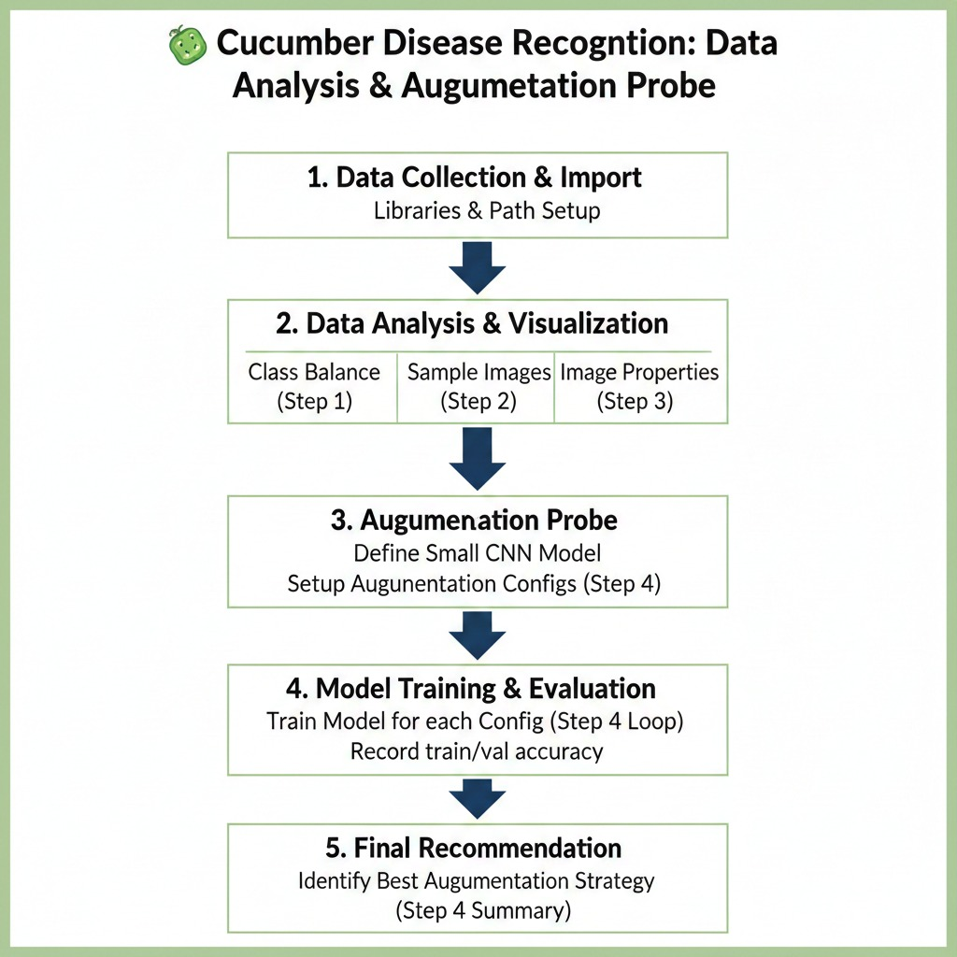
Task 1:Exploratory Data Analysis

Slide 6
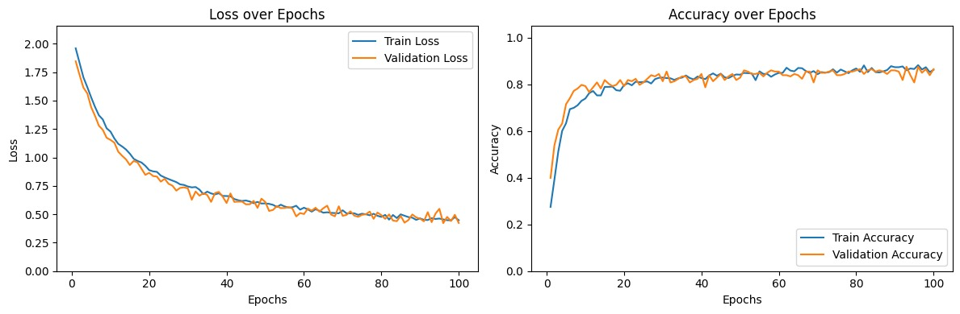
Task 2: Supervised Pre-trained Model(EfficientB0)

Slide 7
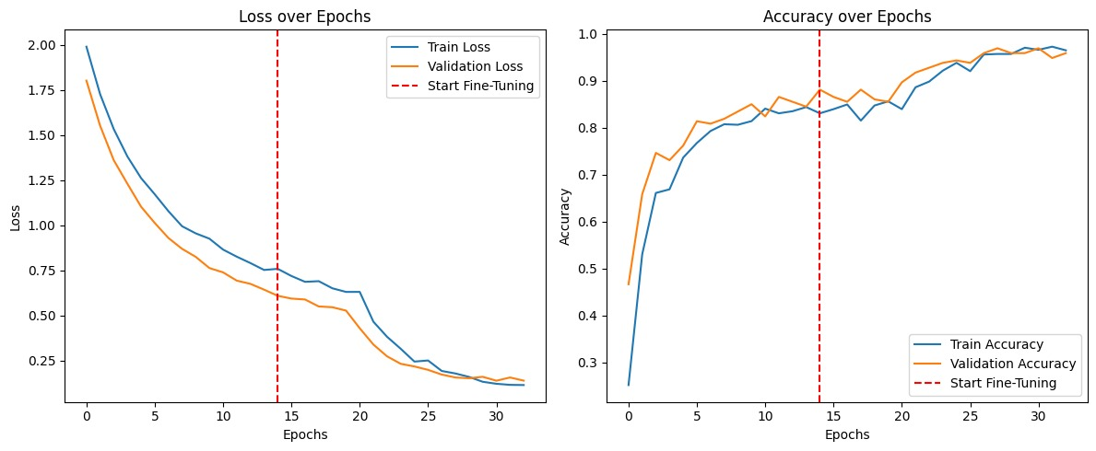
Task 2: Supervised Pre-trained Model(ResNet_50)

Slide 8
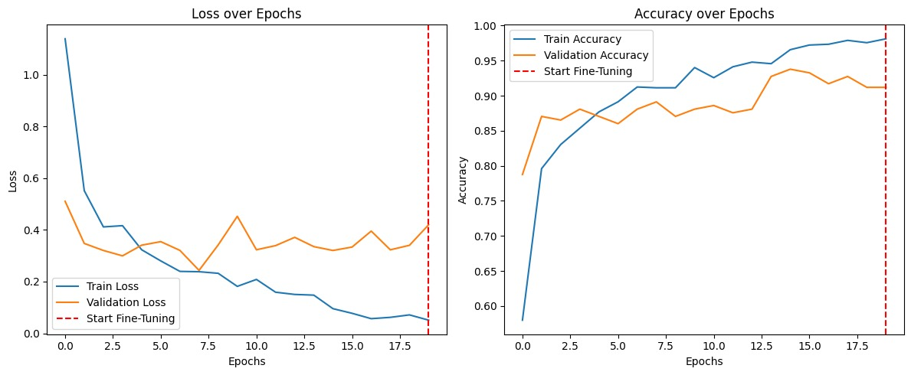
Task 2: Supervised Pre-trained Model(Vgg_16)

Slide 9
Comparison
Model Name | Test Accuracy | Weighted F1- Score | Time(min) | Fine-Tuned? | ROC/AUC
ResNet50 | 0.933 | 0.93 | 96.27 | Yes | Yes
EfficientNetB 0 | 0.8299 | 0.8235 | 84.31 | Yes | Yes
VGG16 | 0.897 | 0.89 | 203.51 | Yes | Yes

Slide 10
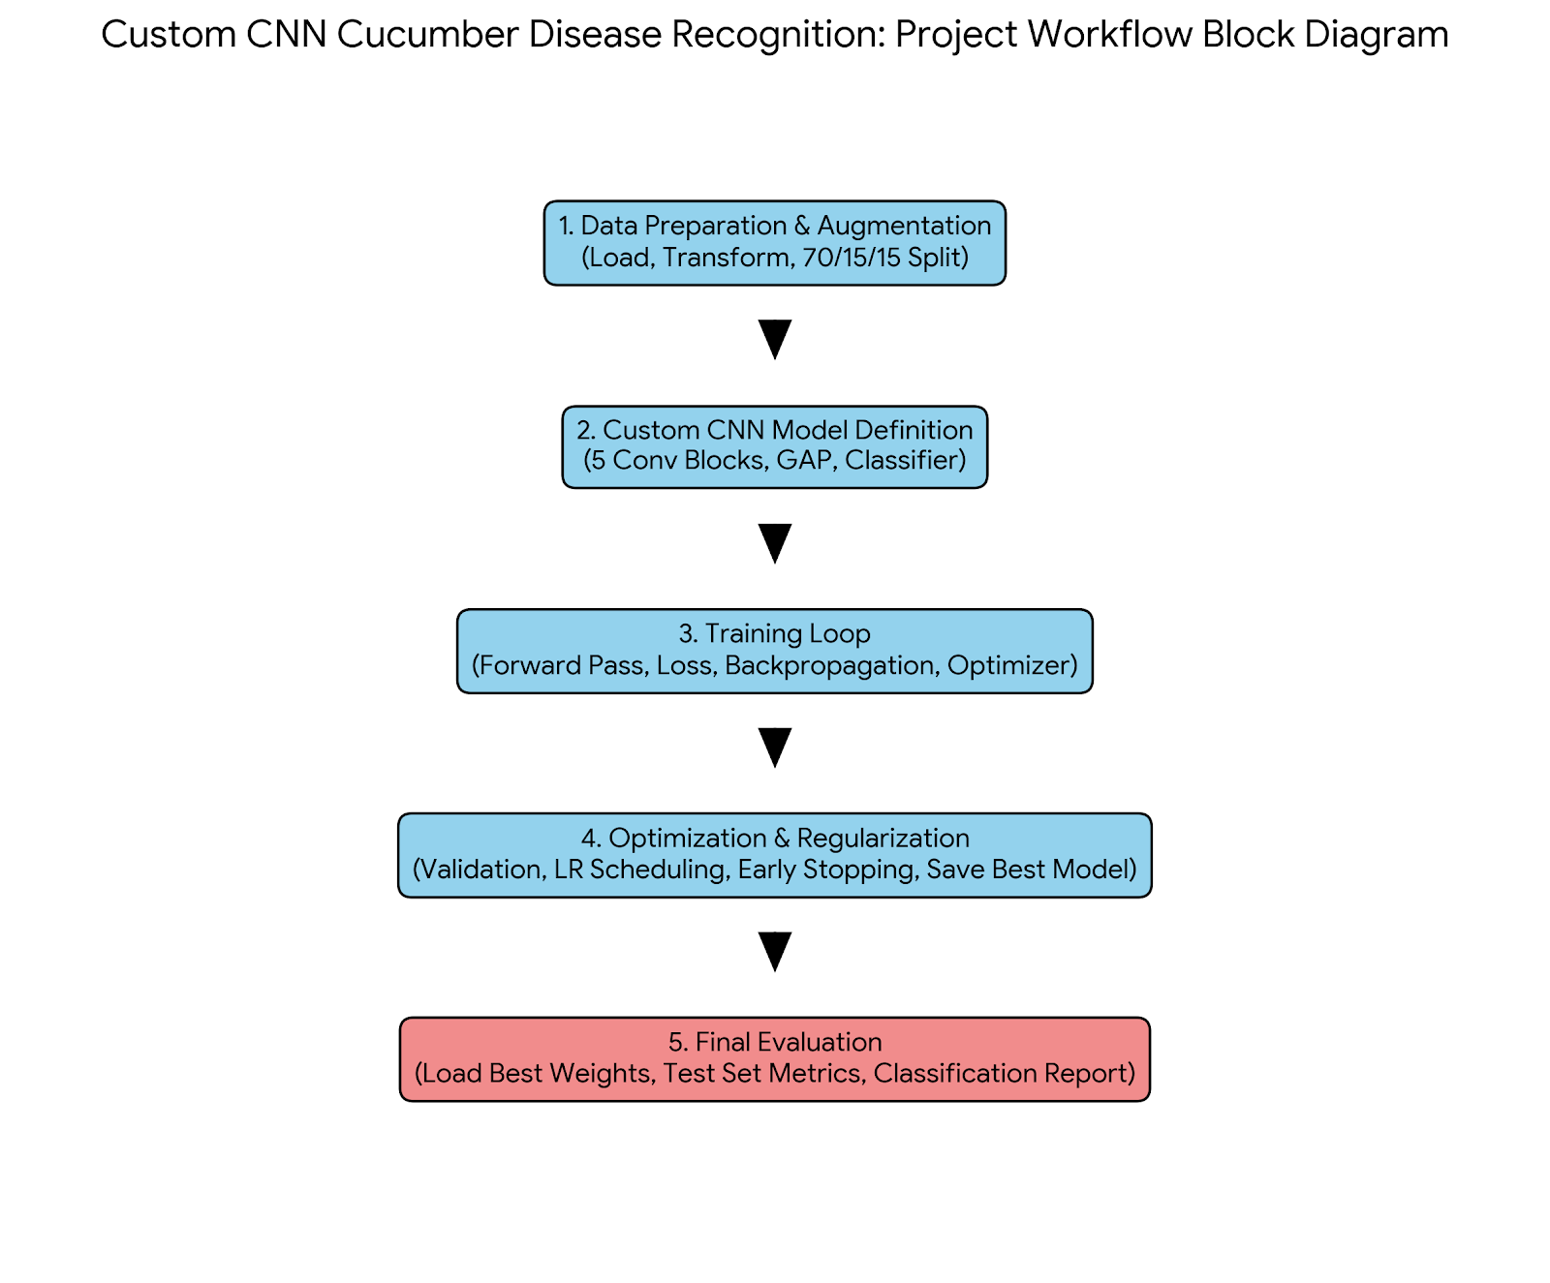
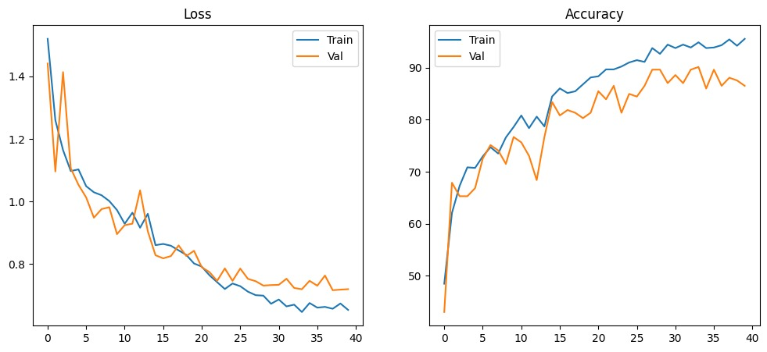
Custom CNN Model

Slide 11
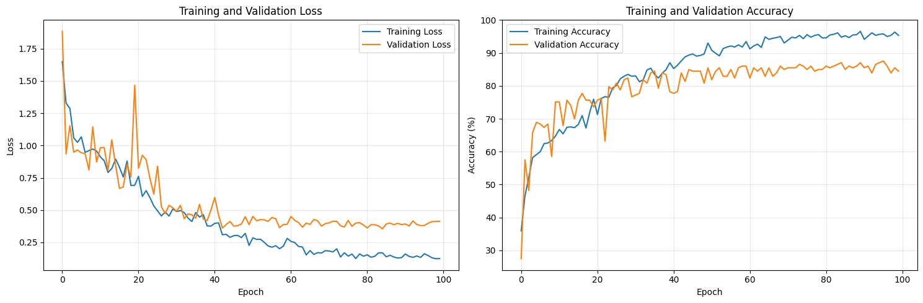
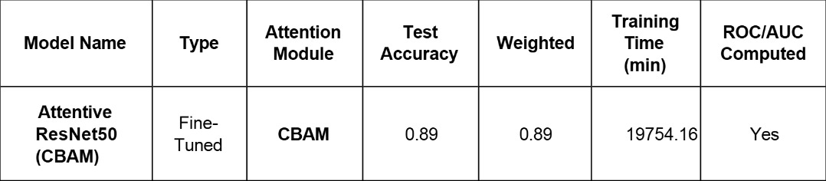
Attention Enhanced CNN Model

Slide 12
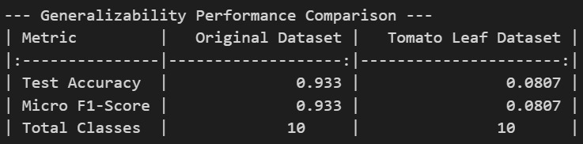

Explainability and Generalizability Testing

Slide 13
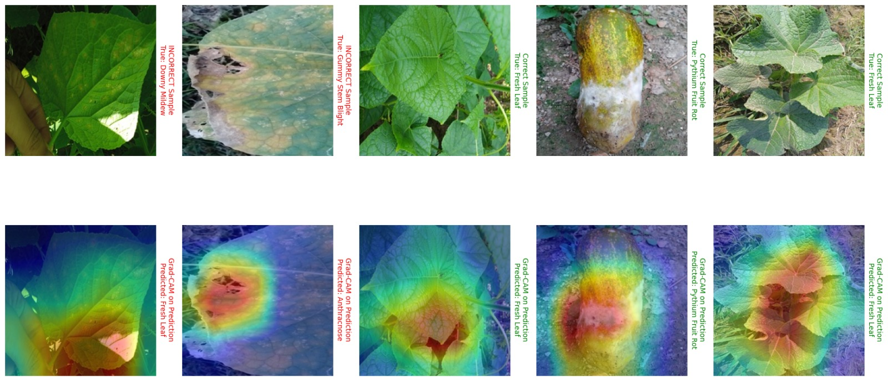
Grad-CAM

Slide 14
Conclusion
This study presents a comprehensive cucumber disease dataset covering eight classes, providing a strong foundation for developing accurate machine vision–based disease recognition systems.
The dataset addresses real agricultural challenges by enabling early detection of diseases
that are difficult to identify with the naked eye.
Integration of deep learning techniques demonstrates the effectiveness of the dataset in training reliable and high-performance recognition models.
Proper data preprocessing, training, validation, and testing ensure the model’s ability to generalize to unseen data.
Overall, the proposed dataset and methodology contribute to improved agricultural efficiency, increased cucumber production, and enhanced food security.

Slide 15

Thank You

